Slide 1
Open Educational Resources: Finding and Utilizing Affordable Course Materials
Amie Freeman and Tucker Taylor
University of South Carolina Libraries

Slide 2
Notes:
We want merit based students, not students who can pay for a better society
College is expensive.
Figure
We wish we were here to fix the whole problem, but we can’t (today). But, as librarians, we can help control some of the costs. (Textbooks)
Amie

Slide 3
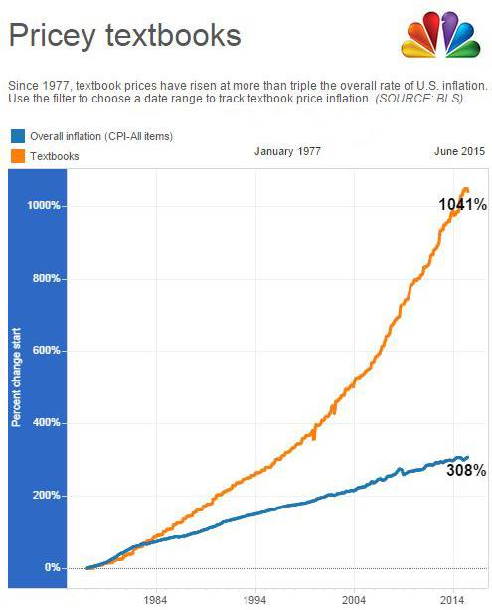
Image Credit NBC News
http://www.nbcnews.com/feature/freshman-year/college-textbook-prices-have-risen-812-percent-1978-n399926
Notes:
Since 1978, college textbook costs have increased 1041%. Over the past decade, college textbook prices have increased by 82 percent, or three times the rate of inflation, from report report.
Two flaws in the textbook market:
5 textbook publishers control more than 90% of the $8.8 billion market. No serious market competition.
Textbook publishers benefit from a fundamental market flaw in the college textbook market. No direct interaction between the producer and the consumer--with normal markets, like the automobile market, the consumer exercises control over prices by choosing to purchase products that priced best for their value. This consumer choice forces producers to price their products competitively. In the textbook market, this consumer control is eliminated by the fact that the professor, not the student/consumer selects the product, and the student/consumer actually expends the money. Because of this, the student is a captive market, and traditional publishers are able to drive continually prices higher without fear of market repercussion. (just like prescriptions-companies market to doctors, not patients and doctors pick the meds)
Amie

Slide 4
You know that textbooks are expensive.
average cost: $1240/year
Notes:
We all know that textbooks are expensive. So let’s talk about what else you already know:
1200 average
worse for freshman, survey classes
use usc’s example
community colleges get hit harder
exponentially more than cost of living now--how long will the avg student have to save before they can afford textbooks.
WHY: monopoly of textbook publishers, same problem as with pharmaceuticals
Tucky

Slide 5
Around the State - 2014
USC Upstate $800-1,200
Coker $1,000
Winthrop $1,000
USC $1,008
Clemson $1,138
Coastal $1,147
Furman $1,200
Piedmont Tech $1,200
College of Charleston $1,207
Charleston Southern $1,400
Denmark Tech $1,500
Voorhees $1,500
Midlands Tech $1,632
Image Credit: Darwinek
https://commons.wikimedia.org/wiki/File:Flag-map_of_South_Carolina.svg
CC:BY:SA
Notes:
USC looks low by comparison, but the landscape is more nuanced. Since we have a lot of upper level and graduate programs, these textbook averages do not tell the full story of our average undergraduate.
For many students and families already struggling to afford a college degree, especially in SC, that is simply too much – meaning more debt, working longer hours, or making choices that undermine academic success.
Tucky

Slide 6
USC
$1377 Your first semester
190 hours of minimum wage work
Notes:
Textbook costs obviously affect students who are in lower income brackets more. These students are often first generation college students as well. Additionally, textbook publishers target large survey classes so that they can maximize their profits. This cost also disproportionately hits freshman, who have the least amount of skills at navigating this system as well as are vulnerable for dropping out.
For many students and families already struggling to afford a college degree, especially in SC, that is simply too much – meaning more debt, working longer hours, or making choices that undermine academic success.
Tucky

Slide 7
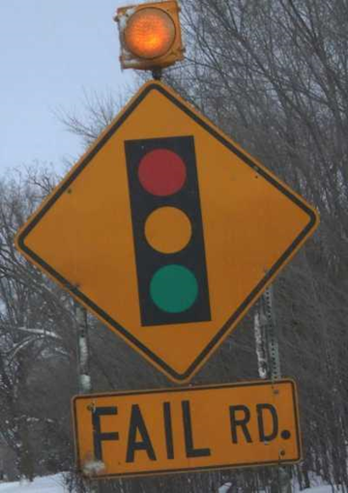
Over the course of an academic career, students report that textbook costs have caused them to:
Not purchase the required textbook 64%
Not register for a course 45%
Take fewer courses 49%
Drop a course 27%
Withdraw from a course 21%
Fail a course 17%
Image CC-BY Dagny Mol http://tinyurl.com/prdrmw4
http://florida.theorangegrove.org/og/items/10c0c9f5-fa58-2869-4fd9-af67fec26387/1/
Notes:
Do you think your students buy and use the book?
Stateof Florida 2012 survey
http://www.openaccesstextbooks.org/%5Cpdf%5C2012_Florida_Student_Textbook_Survey.pdf
Amie

Slide 8
Image CC-BY
http://tinyurl.com/nq7e5sq
Graham Richardson
Notes:
Amie

Slide 9
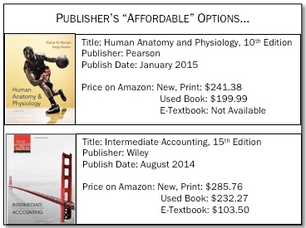
Current Solutions
Band-Aids: Textbook rentals Online Different editions Library textbook checkout
Image CC-BY www.studentpirgs.org/textbooks
Credit Student Pirgs
Notes:
What are some solutions that have been tried, or have been presented as the answer to all of the problems? rental, online, used: still expensive and restrictive
library textbook program: expensive, not sustainable, only so many students can use at a time (access is a major problem)
Rental-still expensive, can’t use fully--can’t highlight, write, etc or won’t get money back
OPEN
Tucky

Slide 10
Open educational resources (OER) means teaching, learning, and research resources that reside in the public domain or have been released under an intellectual property license that permits their free use and repurposing by others.
Notes:
So, What Are Open Textbooks?
Open textbooks are high-quality college texts with an "open" copyright license allowing the material to be freely accessed, shared and adapted.
They are: a significant cost saver to students
· Ability to be accessed and downloaded onto computers, mobile devices, and e-readers
· Allow faculty customization in order to tailor to their individual classes and learning objectives
Many are PEER REVIEWED and go through similar evaluation processes to traditional textbooks.
Next slide:
Of students surveyed, 82 percent said they would do significantly better in a course if the textbook were free online and a hard copy was optional. (http://www.ohiopirg.org/sites/pirg/files/reports/Ohio%20PIRG%20-%20Fixing%20Broken%20Textbooks%20Report.pdf) http://www.studentpirgs.org/textbooks
Faculty benefits:
Instructors also benefit from the flexibility of open textbooks.
Texts are free online, all students have access to the material, regardless of their financial circumstances. More access to knowledge=students doing better in course.
Most open licenses permit instructors to create customized versions of the textbook for use in their own classroom. For example, you could remove unwanted chapters, change notations, or insert your own sections and examples. You can distribute their customized versions online, or have them printed for students by the bookstore.
It puts control back into the hands of the educators
Amie

Slide 11
What is “Open”?
Free Available at no cost to students | 5 “R”s Retain Reuse Revise Remix Redistribute
Notes:
Lots of benefits to using open materials, but we’re going to focus on the top two. First, and this is everyone’s favorite: FREE. Your students can access these materials at absolutely no cost.
Also benefits to you personally: you can personalize your class with these materials. Not bound by the structure of a traditional textbook or course layout--
Retain - You, your students, your TAS, have the right to make, own, and control copies of the content (e.g., download, duplicate, store, and manage) day one until you die-not going to expire like a rented or licensed book might
Reuse - You can use the content in a wide range of ways (e.g., in a class, in a study group, on a website, in a video)
Revise - the right to adapt, adjust, modify, or alter the content itself (e.g., translate the content into another language, or make it disability friendly)
Remix - the right to combine the original or revised content with other open content to create something new (e.g., if you don’t like a chapter’s content, you can take a chapter from another OER and replace it)
Redistribute - the right to share copies of the original content, your revisions, or your remixes with others
Amie

Slide 12
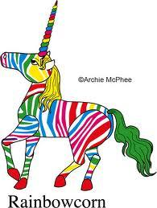
Myths
Online = free
Everything on the internet
is junk
Publishers add benefit
Image Archie McPhee CC-BY-ND
www.mcphee.com/blog/
Notes:
Tucky

Slide 13
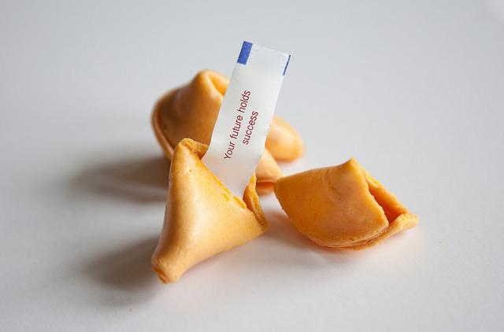
Using OERs: Benefits for the Classroom
Image www.flazingo.com
CC-BY-SA
Notes:
All students, regardless of background, have EQUAL OPPORTUNITIES to succeed in the course. There is no cost barrier determining who can pass the course. Successful students=better teaching, better course evaluations
All students will have access from day one and can study from the start. They can use ANY device, wherever they are, and can even print for minimal cost---no delay in learning, can jump right in and do better in the course, better grades, better reviews for you.
You have CONTROL over your material--if you don’t like something, take it out. If you like something from somewhere else, put it in. Mix and match, add in your own stuff. You can do whatever fits your needs best.
No digital rights management--you can reproduce your material in any way you see fit. Post it wherever, however--on blackboard, print out, etc.
Tucky

Slide 14
OER Benefits
Free (or low cost print)
Adaptable/customizable/creatable
Many are peer reviewed, very high quality
Focused on high enrollment courses
Very little copyright concern
Allowed to make web accessible
Makes our required course materials available to everyone
Students have access first day of class
Notes:
Recap
Tucky

Slide 15
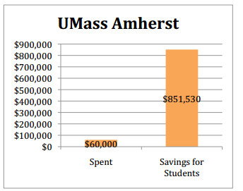
University of Massachusetts, Amherst
2011-Open Education Initiative
Faculty to convert
classes from traditional textbook
use to OERs
Students saved an average
$125.98 per course
Nearly $1 million saved
Image CC-BY www.studentpirgs.org/textbooks
Notes:
Open Education Initiative, University of Massachusetts, Amherst
Goal: find alternatives and replace high cost textbooks
Offer grants from $1000 to $2500 to switch from a traditional textbook to (depending on class size and monetary impact)
Library staff oversee initiative, give trainings and workshops, offer one on one help
Investment of $60,000 in grants has led to savings of over $850,000
Figure does not include faculty who CONTINUE using these books into following semesters--if you take this into account, the figure nears 1.5 million
Amie

Slide 16
Tidewater Community College: A Success Story
Z-Degree
$128,000 saved first year
Drop rates decrease 6 %
Access from day one
Degree more attainable for ALL students
Image CC BY SA www.flickr.com/photos/11247304@N06/1340979055/
Notes:
Z Degree-the nation’s first zero textbook cost associate degree
All courses required to make the switch to open educational resources instead of traditional textbooks
In the first semester alone, over 60,000 dollars saved (students saved approx 1200 year)
Drop rates decrease 6 % in z courses
All students have access to ALL course materials on day one
According to Daniel DeMarte, TCC’s vice president for academic affairs and chief academic officer, “By eliminating textbook costs, the Z-Degree makes a college degree more affordable and attainable for many of our students. Our use of OER is also changing the conversation about student success and learning outcomes as we measure results and identify what are the best resources to teach a particular outcome. That is the real power of open educational resources.”
Amie

Slide 17
South Carolina Schools React
Notes:
Tucky and Amie!

Slide 18
Funding
Universities (Rice University, SUNY, Purdue, Oregon State)
Foundations (Hewlett Foundation, Gates Foundation)
Governments (California, British Columbia)
Libraries (GALILEO-ALG)
Nonprofits (OER Commons)
http://www.slideshare.net/djernst (edited) Credit: David Ernst
Notes:
Someone has to pay for all of this though, right? Are people just supposed to work for free? Qualified experts paid through variety of funding sources to create good OERS
There are open textbook publishing companies, who follow the typical process of authoring, editing, and reviewing, ix and pay royalties to authors based on the sale of print books and supplementary materials. In other cases, authors or teams of authors are funded by grants from foundations, their institutions, or the government. Open textbooks still cost money to create, but they are produced and distributed in a way that allows maximum benefit.
In 2012, the California State Legislature directed the public higher education systems in the state to create an online library with open educational resources and textbooks in order to increase faculty adoption of high quality, affordable or free materials to save students money. (Support provided by the William & Flora Hewlett Foundation and the Gates Foundation to match the State of California’s funding, mandated by SB 1052 and SB 1053)
Amie

Slide 19
So I can just google these, right?
Image CC-BY Sean MacEntee
Image http://tinyurl.com/mdhk6ua
Notes:
So how do I find these materials? I can just google them, right? NOPE!
Or at least, we don’t recommend it.
Quality control
Licensing issues
making sure they aren’t going to disappear
Quality, true OERs aren’t always easy to find, but…
THAT’S WHY YOU HAVE US (see next slide)
Amie

Slide 20
Notes:
So, you found something that has potential, but you’re still not sure of the quality. Now’s the time to check out the CRAP Test
Currency, Relevance and accuracy, Authority (Rice w/ Hewlett vs/ stuff that’s published by interest groups), purpose-was it created to sway
Tucky

Slide 21
Notes:
So we know what open is and how to evaluate resources.
So--you want to know how to find, but there’s one more step.
How do you figure out what’s open?
Most things covered by copyright.
Here’s how people let you know what IS available for you to use works in this manner?
The main way we know is from the Creative Commons license--granting an EXCEPTION to copyright law
Creative Commons-brainchild of Stanford folks
Search through their material as easily as google or even through google
You need to
Tucky

Slide 22
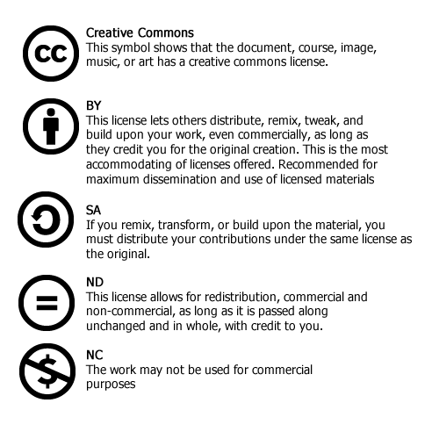
Notes:
Most CC-BY
You can reuse however you want, even commercially--just have to give credit to whoever created it.
That’s what we want to do! give credit where credit’s do.
You can require others to do the same with your work. (If they use your work, must share-alike)
Can’t change--not open (art)-no derivatives
Tucky

Slide 23
Notes:
Show examples of CC license (Peter Suber, print outs, etc). Reusing image from two pages previous
Show search page
Tucky

Slide 24
Try an advanced Google search
Limit by license type
Add the image search
Image www.google.com
Notes:
Okay, so you really like Google. We’re going to let you Google--but do it smartly!
TUCKY-STATISTICS
show how it can be written out or the symbol
Tucky

Slide 25
Merlot
Large searchable database
Many types of open educational
content
Anyone can contribute
Image www.merlot.org
Notes:
Show from LibGuide---TUCKY—criminal justice
MERLOT is a free resource designed primarily for faculty, staff and students of higher education from around the world to share their learning materials and pedagogy. MERLOT has one of the largest collections of open textbooks with thousands of free open textbooks in the collection.
Some advantages of the MERLOT textbook collection include:
Largest known collection of thousands of free open textbooks.
Some of the textbooks have MERLOT Peer Reviews.
MERLOT Members may add comments that users can read.
Learning Exercises can be added to the description of the textbook.
Textbooks can be added to your personal collection.
Textbooks are searchable by subject.
K-12
CIVIL RIGHTS
Tucky

Slide 26
OER Commons
Search, browse, and evaluate resources from a single access point
More than textbooks--find digital collections, lesson plans, and more
Quality resource for K-12 classrooms and higher education
Image OER Commons https://www.oercommons.org/
CC-BY-NC-SA
Notes:
Single point of access from which educators and librarians can search, browse, and evaluate resources in OER Commons’ growing collection of over 50,000 high-quality OER that have been CATALOGED and ORGANIZED. Everyone can find what they need efficiently--way easier than scouring whole web. More than just textbooks--digital collections, course work, lesson plans
Particularly helpful for K-12, can search by common core materials, etc.
Also a platform to create
Search:
Chemistry, Physical Science, College/Upper Division, Standard
Show options on left
Bioinorganic Chemistry
Amie

Slide 27
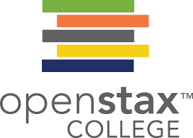
OpenStax
Peer reviewed
Faculty were paid to create
Rice University
Competitive with professional textbooks
Image: http://openstaxcollege.org/
Notes:
"OpenStax College offers students free textbooks that meet scope and sequence requirements for most courses. These are peer-reviewed texts written by professional content developers." Open Stax is an initiative of Rice University and Connexions.
AMIE-ANATOMY
https://www.openstaxcollege.org/books
Show anatomy Get this book
Options
this is the mercedes
mandated to find 15 most high volume courses
designed to compete w/ tbs already on market
Mostly college level
http://openstaxcollege.org/

Slide 28
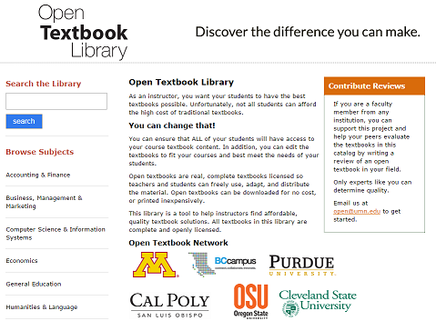
Open Textbook Library:
University of Minnesota
Faculty reviews
Image http://open.umn.edu/opentextbooks
Notes:
Amie-BIOLOGY, show peer reviews (one specific example)
Mostly college level

Slide 29
Additional Resources
BC Campus OpenEd
BookBoon
California State ISBN Textbook Finder
Center of Math
College Open Textbooks Collaborative
Community College Consortium for Open Educational Resources
Directory of Open Access Books
MIT Online Textbooks
Open Access Textbooks
Open.Michigan
OpenStax CNX
Open SUNY Textbooks
Orange Grove
SpringerOpen
Notes:
Tucky

Slide 30
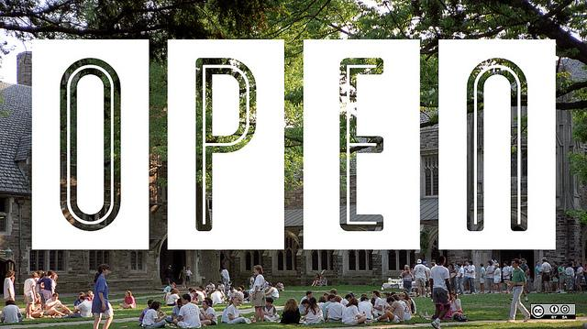
Now what?
LEARN IT
Be an advocate
Find victims partners
TEACH IT
Spread the word
LibGuides
Image CC-BY-SA opensource.com
http://opensource.com/education/12/2/how-teach-undergrads-how-become-open-source-contributors-without-writing-any-code
Notes:
Now you know a few things about why OERs can improve the current campus environment and how to find and evaluate them. What are you next steps?
Tucky

Slide 31
Amie Freeman: dillarda@mailbox.sc.edu
Tucker Taylor: tucky@mailbox.sc.edu

